Slide 1
BDT Final Project
Security log analyzer
Win Htut Aung
Anis Bakhtaoui
Delgerdalai Batjargal

Slide 2
Background Idea
In an era of increasing digitalization, cybersecurity has become a critical concern for organizations worldwide. Analyzing security logs is a fundamental aspect of identifying potential threats and ensuring the integrity and confidentiality of sensitive information. The Security Log Analyzer Big Data Project aims to leverage cutting-edge technologies to streamline the process of analyzing security logs at scale.

Slide 3

Objectives of the Project
Efficient Log Streaming
Real-time Analysis with Spark Streaming
Persistent Data Storage in Hbase
Hive Integration for Analytical Insights
Seamless Integration with Analytics Tools

Slide 4
Project Components
Log Streaming to Kafka using Python
Spark Streaming Consuming Kafka Topic
Saving Data to Apache HBase
Creating External Table in Hive
Using Hive as a Datasource for Analytics

Slide 5
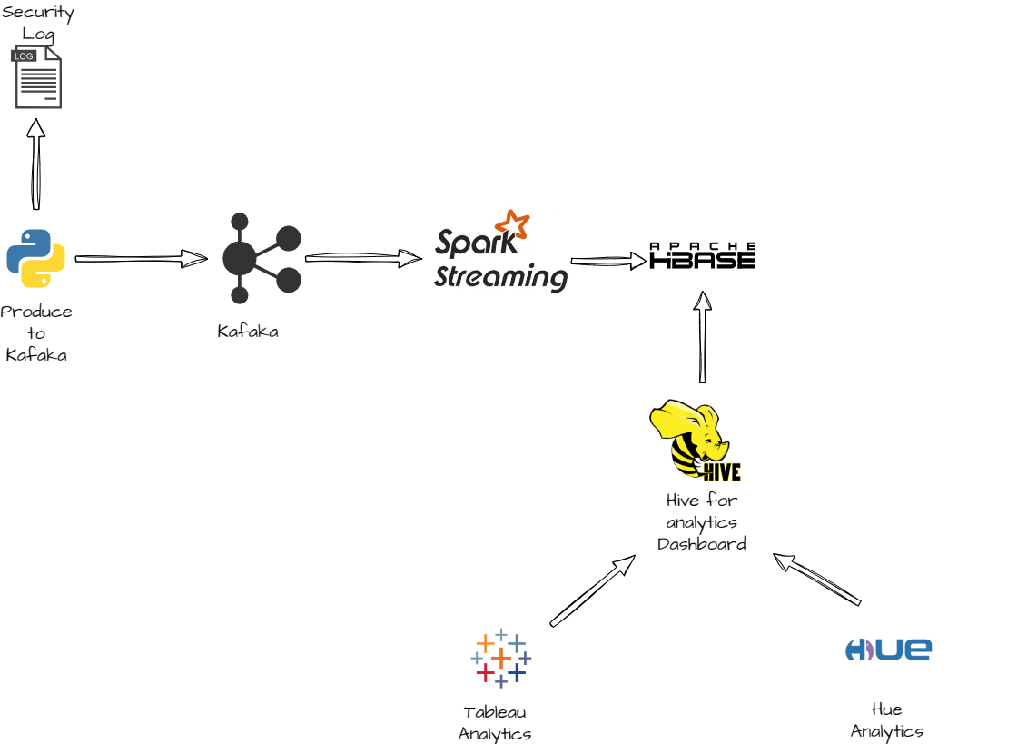
High Level Architecture

Slide 6
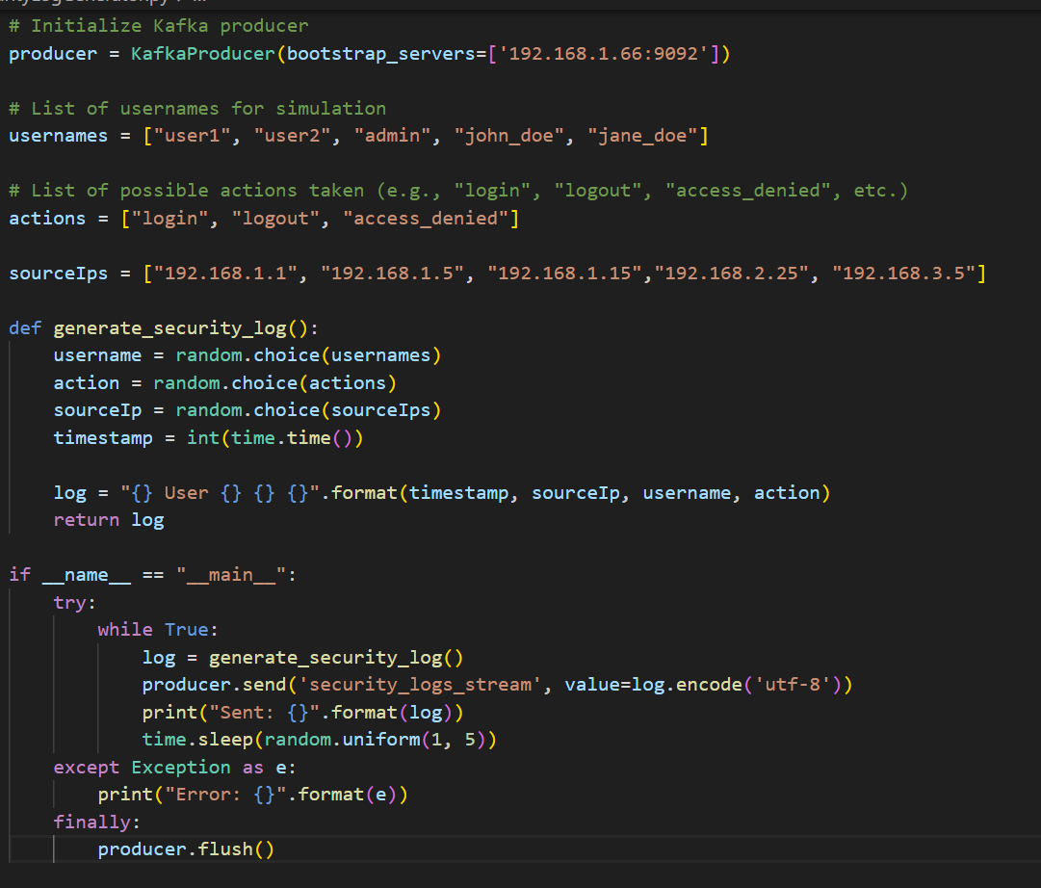
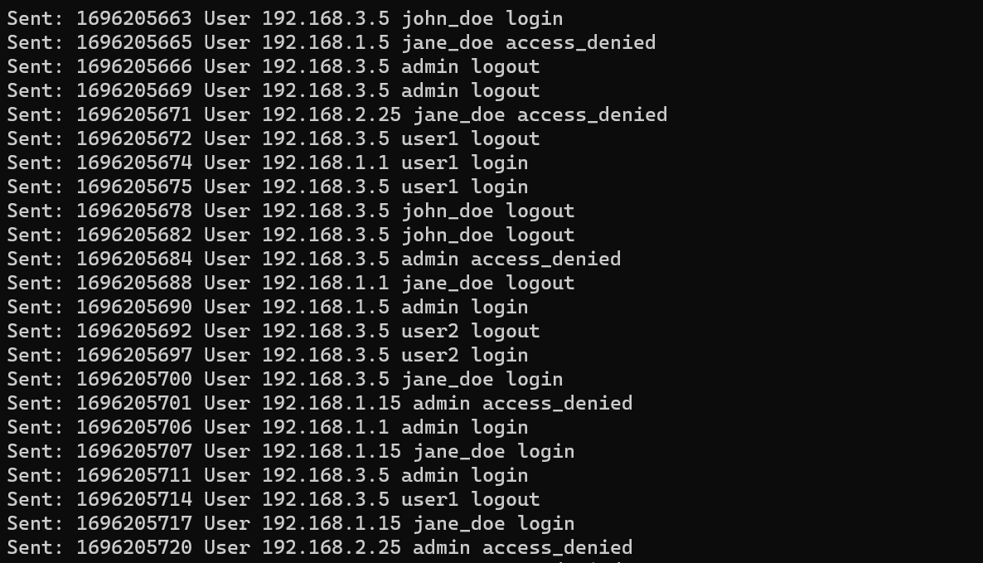
Log Streaming to Kafka using Python
Create security log generator
Stream this log to Kafaka

Slide 7
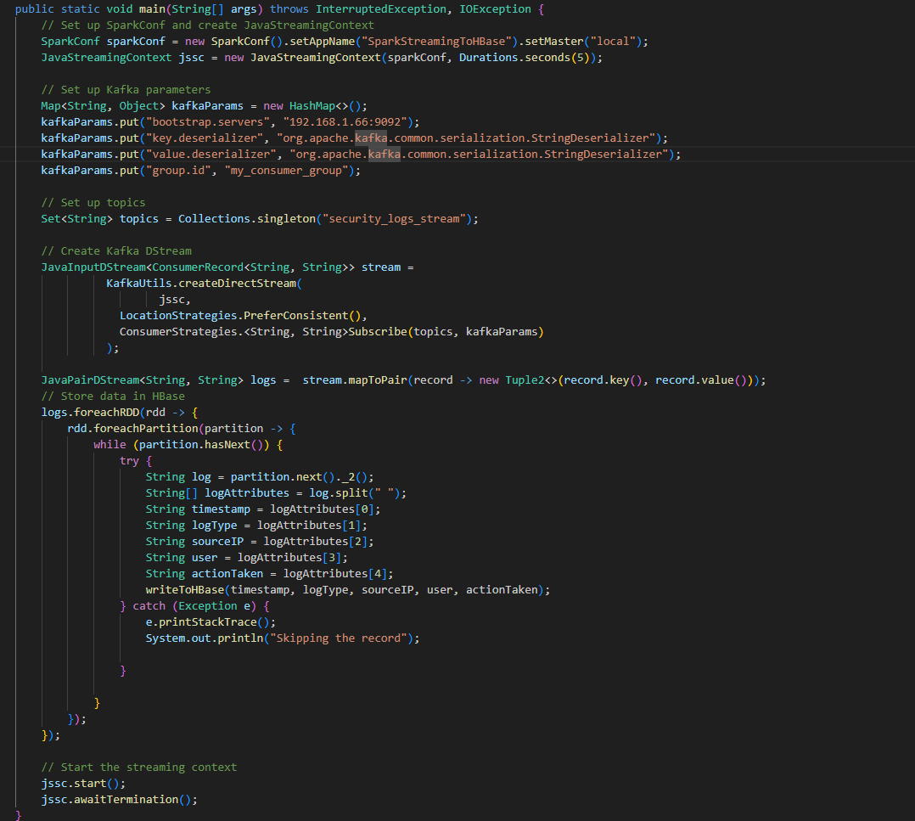
Spark Streaming Consuming Kafka Topic
Using Spark Streaming with Java
Consume from Kafaka Topics “security_logs_stream”

Slide 8
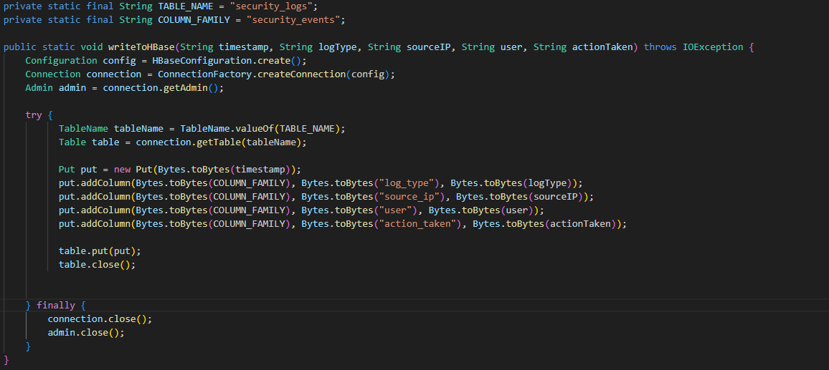
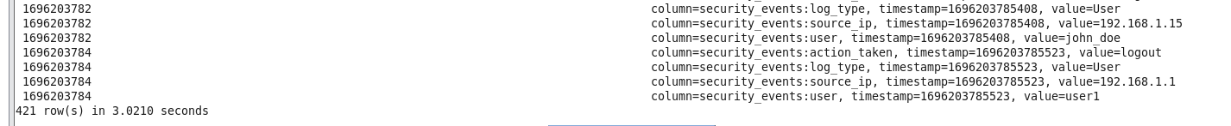
Saving Data to Apache HBase

Slide 9
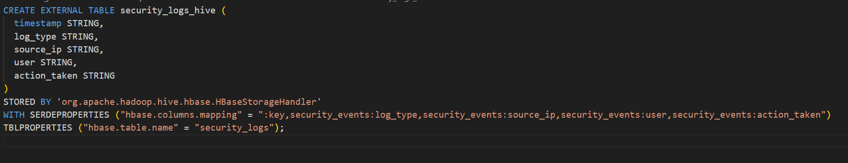
Creating External Table in Hive

Slide 10
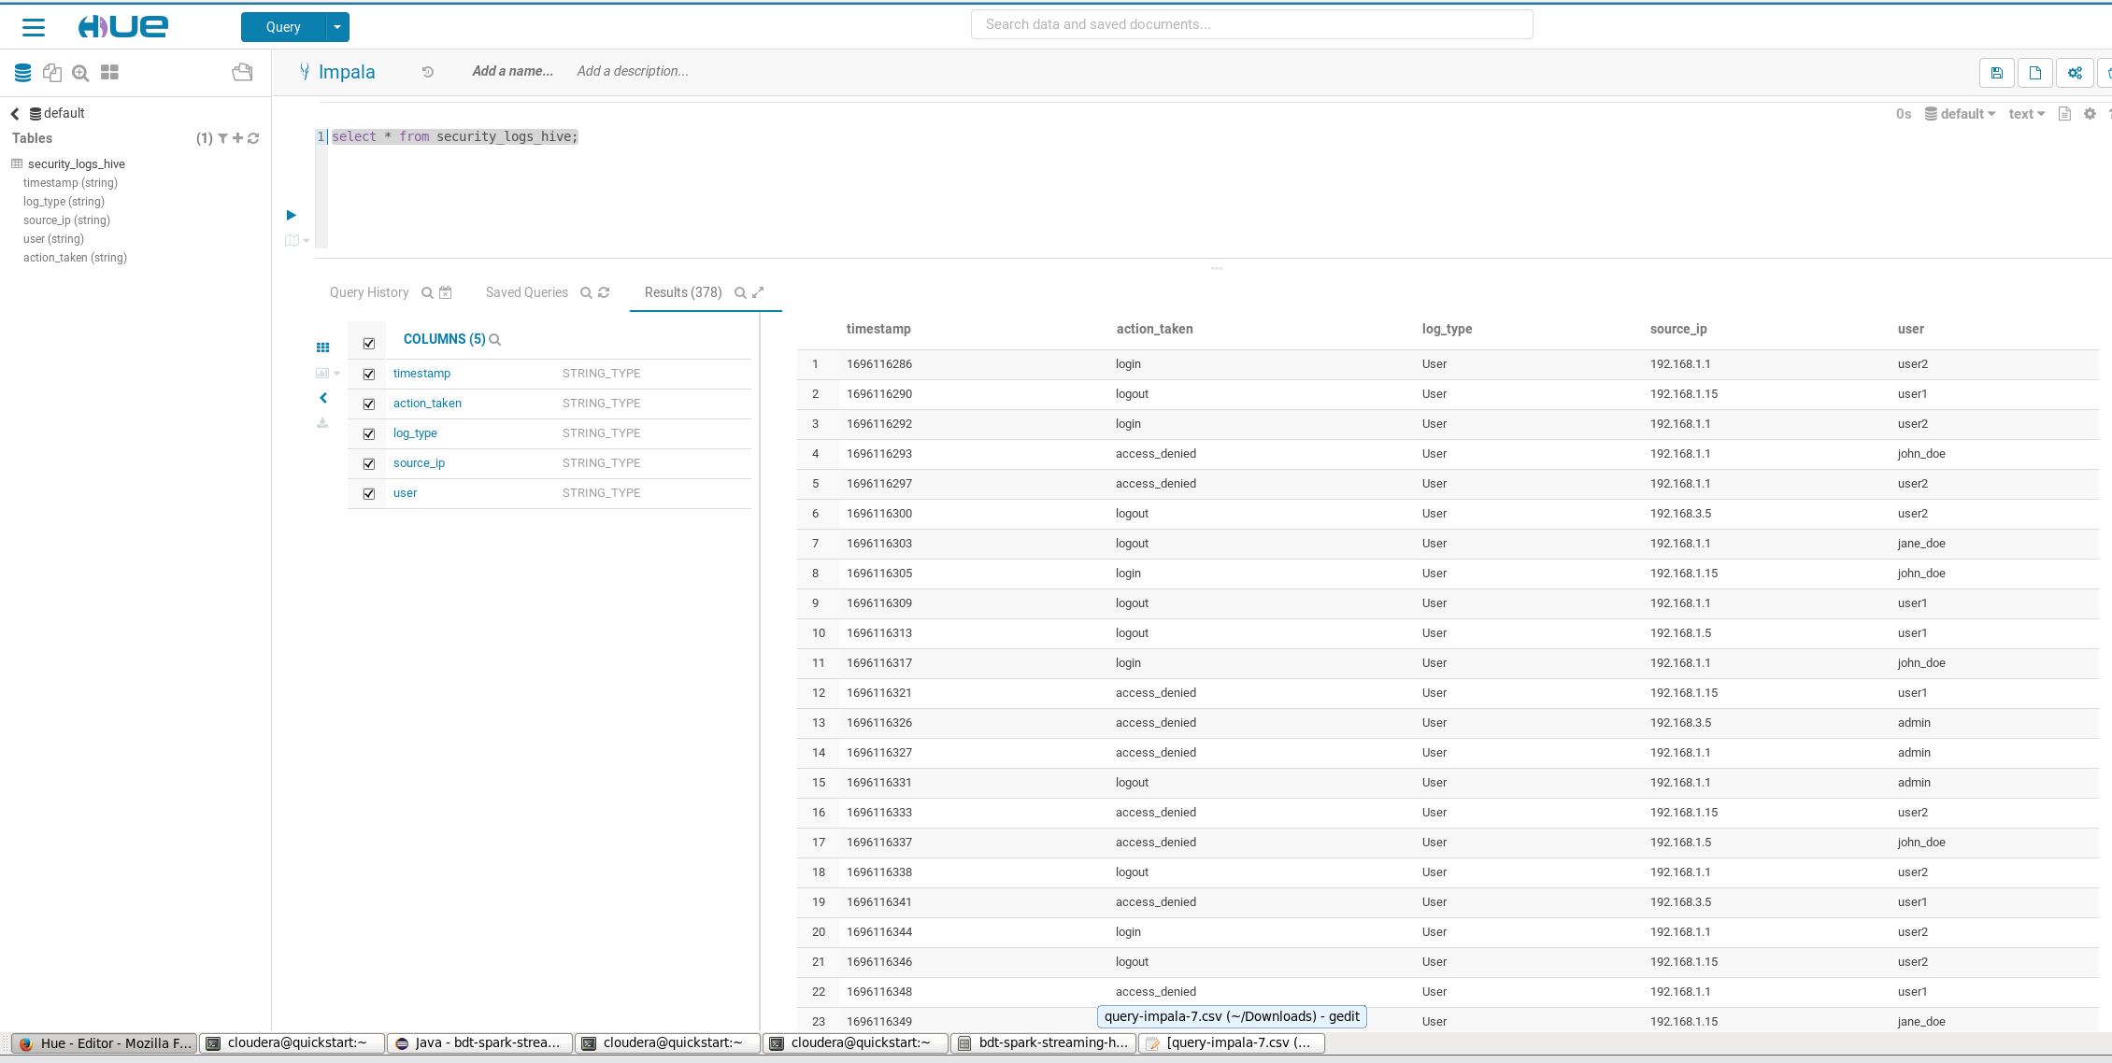
Using Hive as Datasource for Analytics (Hue)

Slide 11
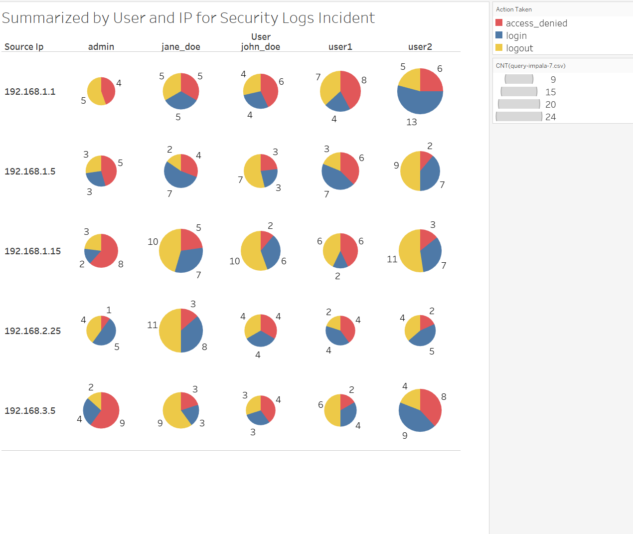
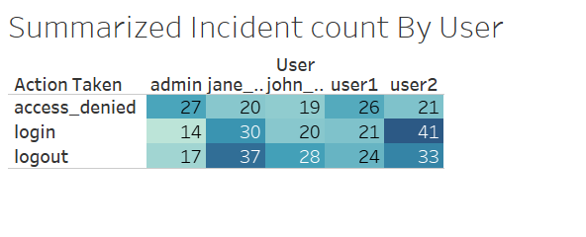
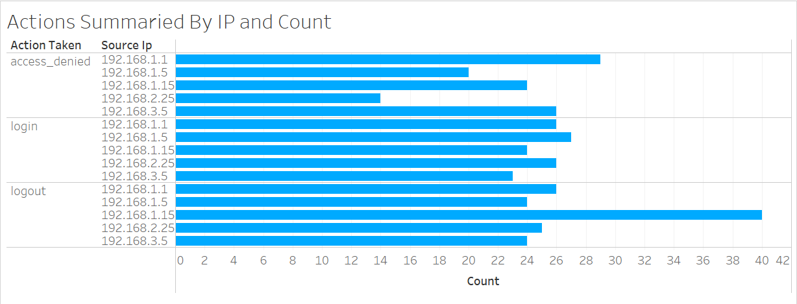
Using Hive as Datasource for Analytics (Tableau)

Slide 12
Notes
Change the kafaka ip in SecurityLogGenertor.py
Change the kafaka ip in SparkStreamingToHBase.java
Create the table in hbase using this command - create 'security_logs', 'security_events’
Create the Hive table CREATE EXTERNAL TABLE security_logs_hive (
timestamp STRING,
log_type STRING,
source_ip STRING,
user STRING,
action_taken STRING
)
STORED BY 'org.apache.hadoop.hive.hbase.HBaseStorageHandler'
WITH SERDEPROPERTIES ("hbase.columns.mapping" = ":key,security_events:log_type,security_events:source_ip,security_events:user,security_events:action_taken")
TBLPROPERTIES ("hbase.table.name" = "security_logs");
Analyze data via the Hue, Tableau

Slide 13
Link to the video recording
Meeting in _General_-20231001_211847-Meeting Recording.mp4 (sharepoint.com)

Slide 14
Link to the Github
winongit/BDT_Security_Log_Analyser: BDT Project - Python - Spark Streaming - Hbase - Hive - Hue - Tableau (github.com)

